Slide 1
In-the-wild Material Appearance Editing using Perceptual
Attributes
Authors: Subias, J. Daniel ¹ and Lagunas, Manuel ²
Speaker: Subias, J. Daniel
¹Universidad de Zaragoza, I3A, Spain ²Amazon

Slide 2
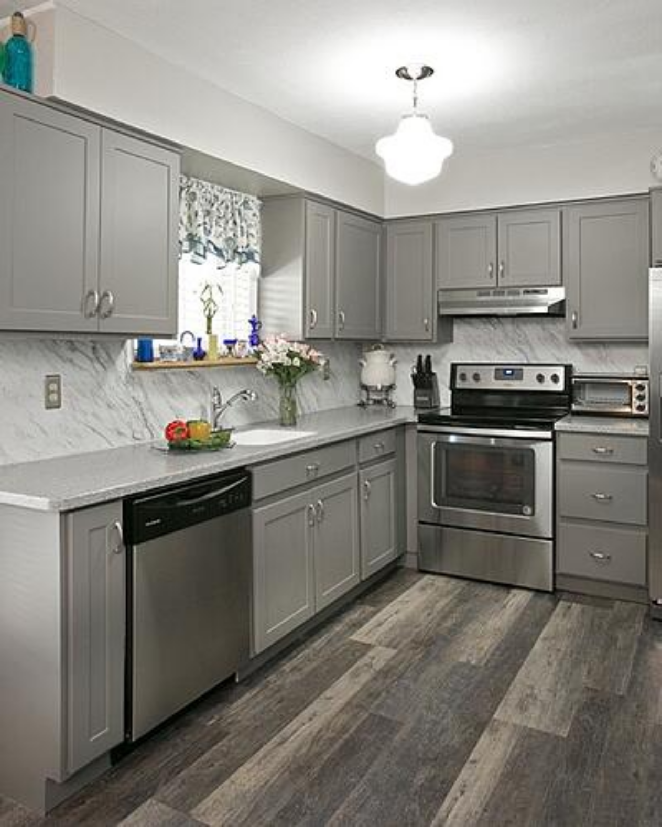
Introduction: Visual Perception
11.05.2023
2

Slide 3
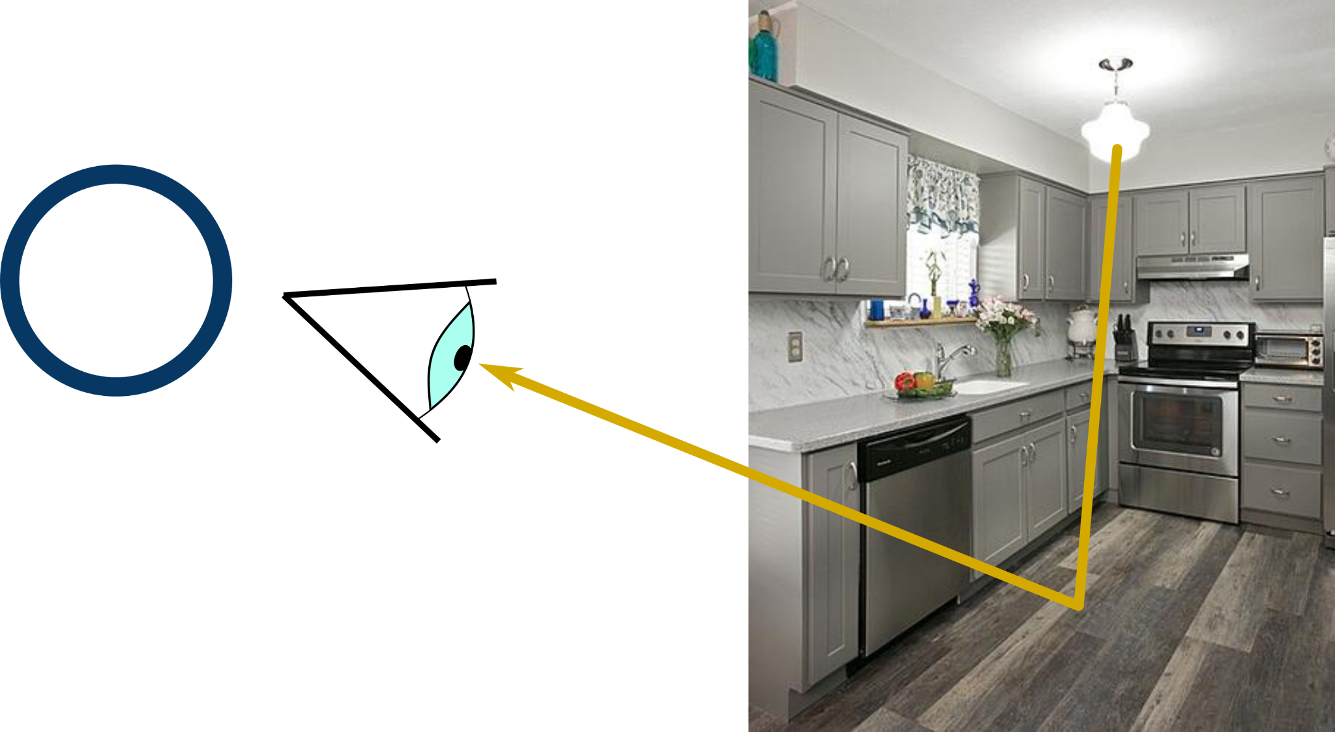
Introduction: Visual Perception
Visual System
?
Wood
🤔
11.05.2023
3

Slide 4
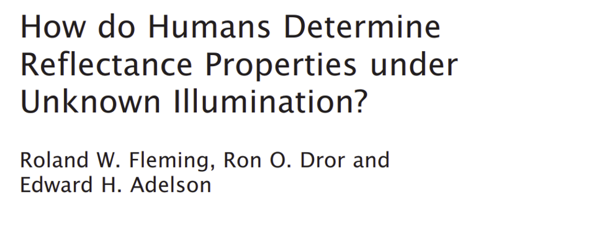
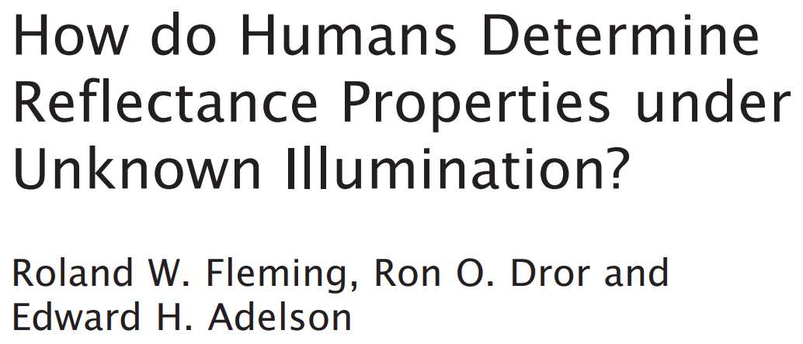
Introduction: Visual Perception
11.05.2023
4
Notes:
Understanding how our visual system interprets our world is a longstanding goal in fields like computer graphics or applied optics, that is yet to be understood.

Slide 5
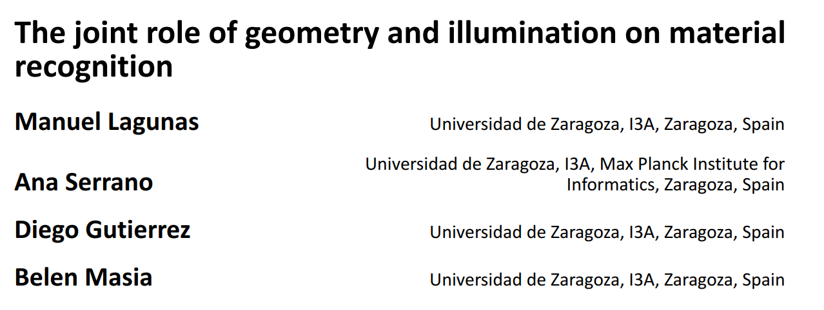
Introduction: Visual Perception
11.05.2023
5
Notes:
Our visual perception of an object is guided by its material properties, but factors such as geometry or lighting conditions also play a role.

Slide 6
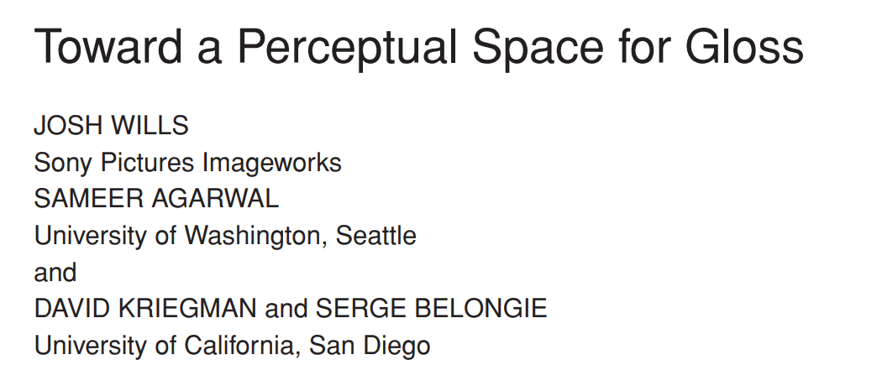
Introduction: Visual Perception
11.05.2023
6
Notes:
To reduce the dimensionality of the problem, previous work has focused on understanding single, high-level perceptual attributes such as glossines

Slide 7
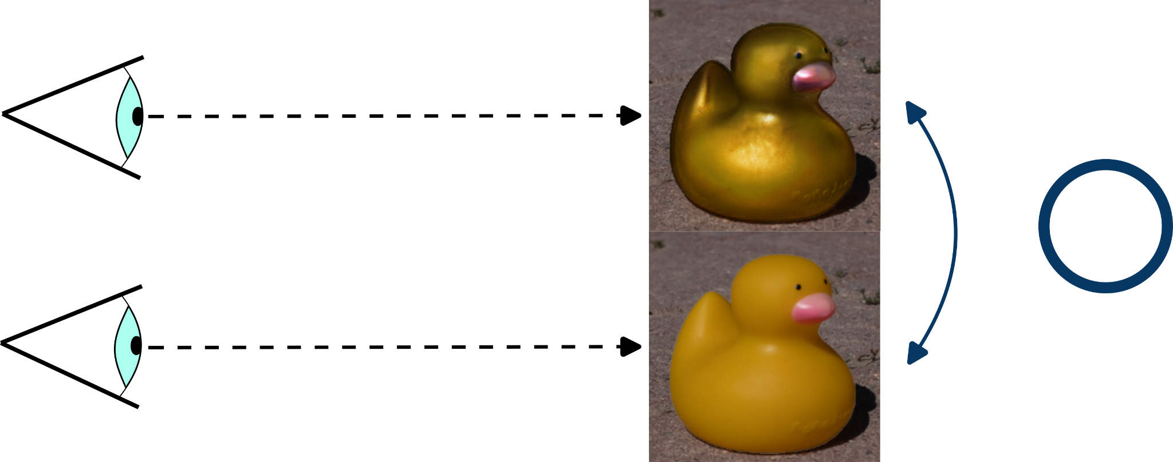
Introduction: Image Editing
Photos
I’m seeing a Metal Duck,
looks heavy
I’m seeing a Plastic Duck,
looks light
11.05.2023
7
Notes:
These attributes are also perceptible when we look at photographs, allowing us to associate

Slide 8
Introduction: Image Editing
Photos
I’m seeing a Metal Duck,
looks heavy
I’m seeing a Plastic Duck,
looks light
11.05.2023
8

Slide 9
Introduction: Image Editing
Photos
I’m seeing a Metal Duck,
looks heavy
Editing
?
I’m seeing a Plastic Duck,
looks light
11.05.2023
9

Slide 10
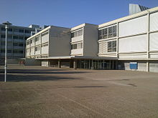
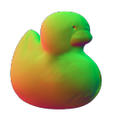
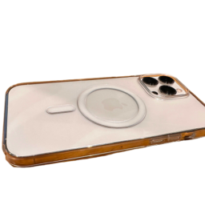
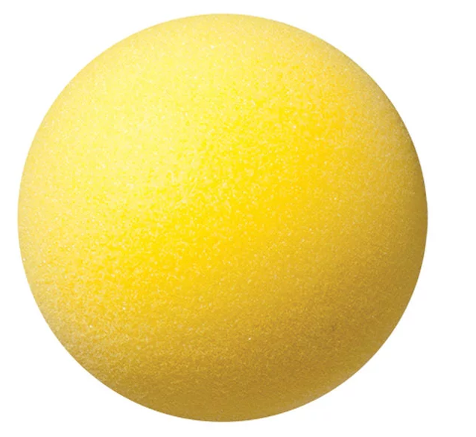
Introduction: Image Editing
Photos
Inverse Rendering
I’m seeing a Metal Duck,
looks heavy
Illumination
Geometry
?
I’m seeing a Plastic Duck,
looks light
Material
Camera
11.05.2023
10

Slide 11
Introduction: Image Editing
Photos
Inverse Rendering
I’m seeing a Metal Duck,
looks heavy
Our Goal:
High-fidelity edits
from a single image
in an intuitive way.
I’m seeing a Metal Duck
Illumination
Geometry
?
I’m seeing a Plastic Duck,
looks light
Material
Camera
I’m seeing a Plastic Duck
11.05.2023
11

Slide 12
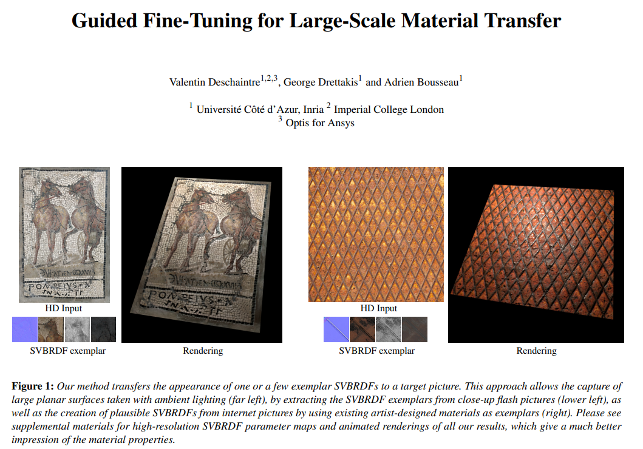
Related Work: [DDB20]
Appearance Transfer
11.05.2023
12

Slide 13
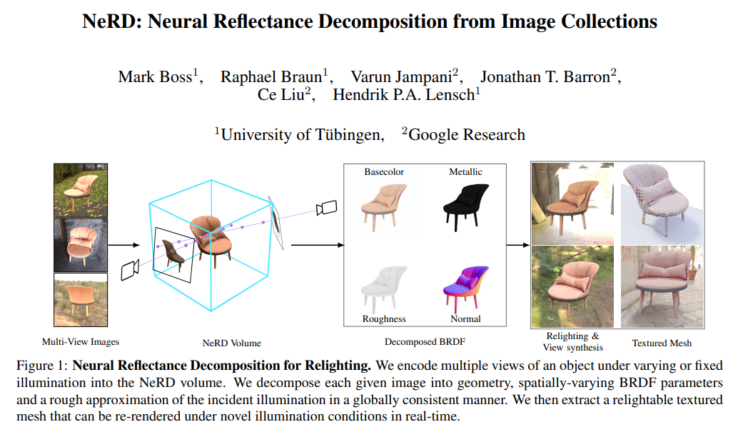
Related Work: [BBJ*21]
Appearance Transfer
Material Decomposition
11.05.2023
13

Slide 14
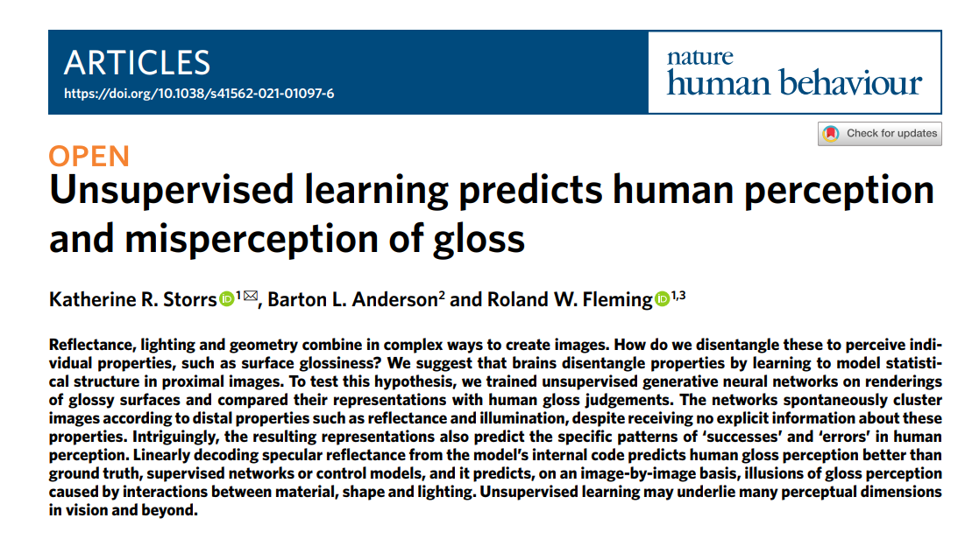
Related Work: [SAF21]
Appearance Transfer
Material Decomposition
Image Compresion
11.05.2023
14

Slide 15
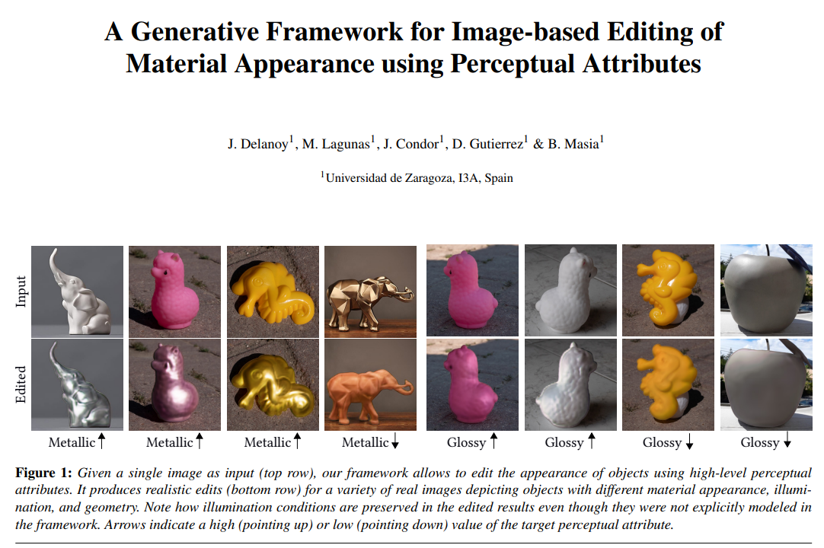
Related Work: [DLC*22]
Geometry still Needed ⨯
11.05.2023
15

Slide 16
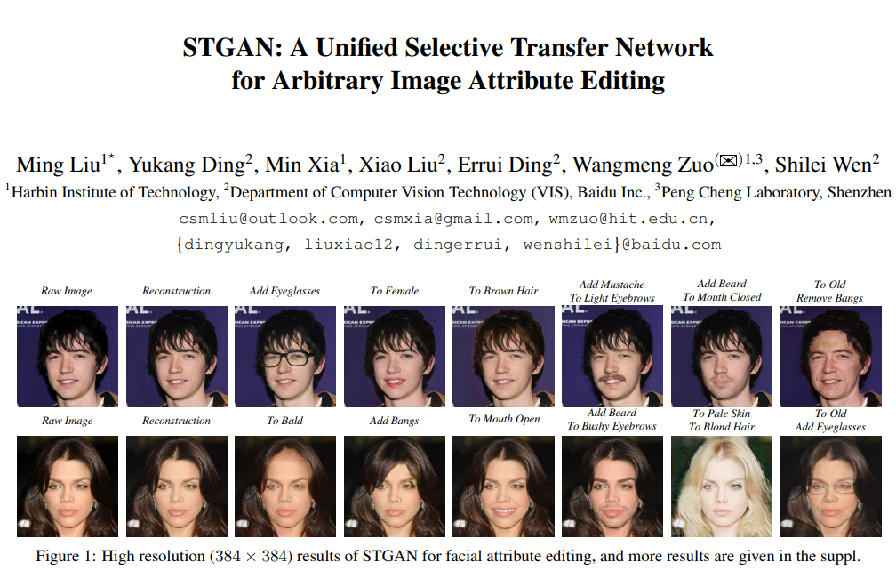
Related Work: [LDX*19]
Geometry still Needed ⨯
High-frequency Details✔
+
11.05.2023
16

Slide 17
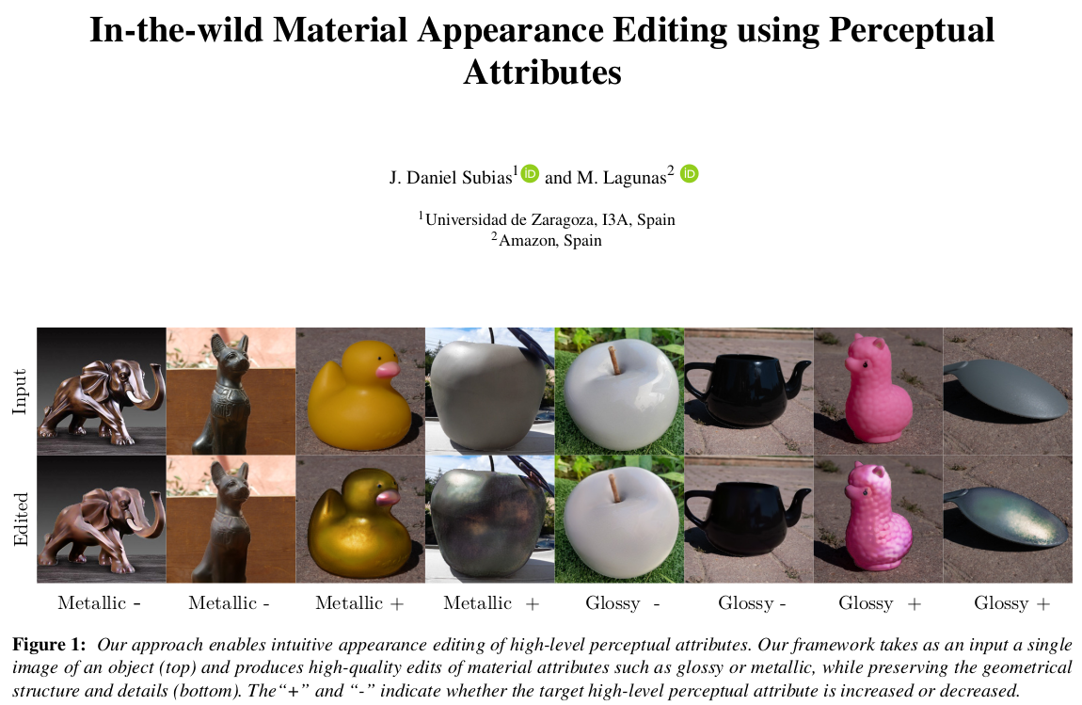
Related Work: Our Work
Geometry still Needed ⨯
High-frequency Details✔
Our Work
+
=
11.05.2023
17

Slide 18
Our Framework: Model Architecture
Input:
Source image x
Target high-level perceptual attribute att_{t} in [0,1]
Our
Framework
11.05.2023
18

Slide 19
Our Framework: Model Architecture
Input:
Source image x
Target high-level perceptual attribute att_{t} in [0,1]
Output:
Edited image y
Our
Framework
11.05.2023
19

Slide 20
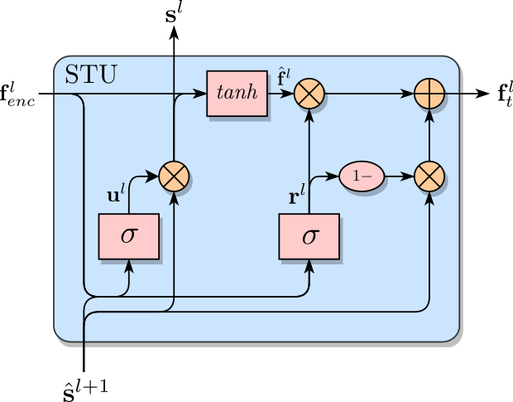
Our Framework: Model Architecture
Input:
Source image x
Target high-level perceptual attribute att_{t} in [0,1]
Output:
Edited image y
Architecture
Encoder-decoder
Selective Transfer Units (STUs)
11.05.2023
20

Slide 21
Our Framework: Training Dataset [DLC*22]
7 Illuminations
11.05.2023
21

Slide 22
Our Framework: Training Dataset [DLC*22]
7 Illuminations
5 Viewpoints
11.05.2023
22

Slide 23
Our Framework: Training Dataset [DLC*22]
7 Illuminations
5 Viewpoints
13 Geometries
11.05.2023
23

Slide 24
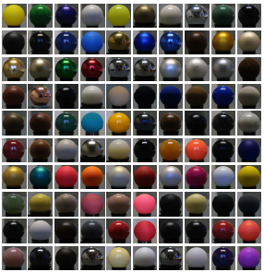
Our Framework: Training Dataset [DLC*22]
7 Illuminations
5 Viewpoints
13 Geometries
100 Materials (from MERL)
11.05.2023
24

Slide 25
Our Framework: Training Dataset [DLC*22]
7 Illuminations
5 Viewpoints
45 500 Total Images
Attribute / Value (att_{s})
Glossy / 0.75
Metallic / 1.00
13 Geometries
100 Materials (from MERL)
11.05.2023
25

Slide 26
Our Framework: Training Dataset [DLC*22]
7 Illuminations
5 Viewpoints
45 500 Total Images
Attribute / Value (att_{s})
Glossy / 0.75
Metallic / 1.00
13 Geometries
100 Materials (from MERL)
11.05.2023
26

Slide 27
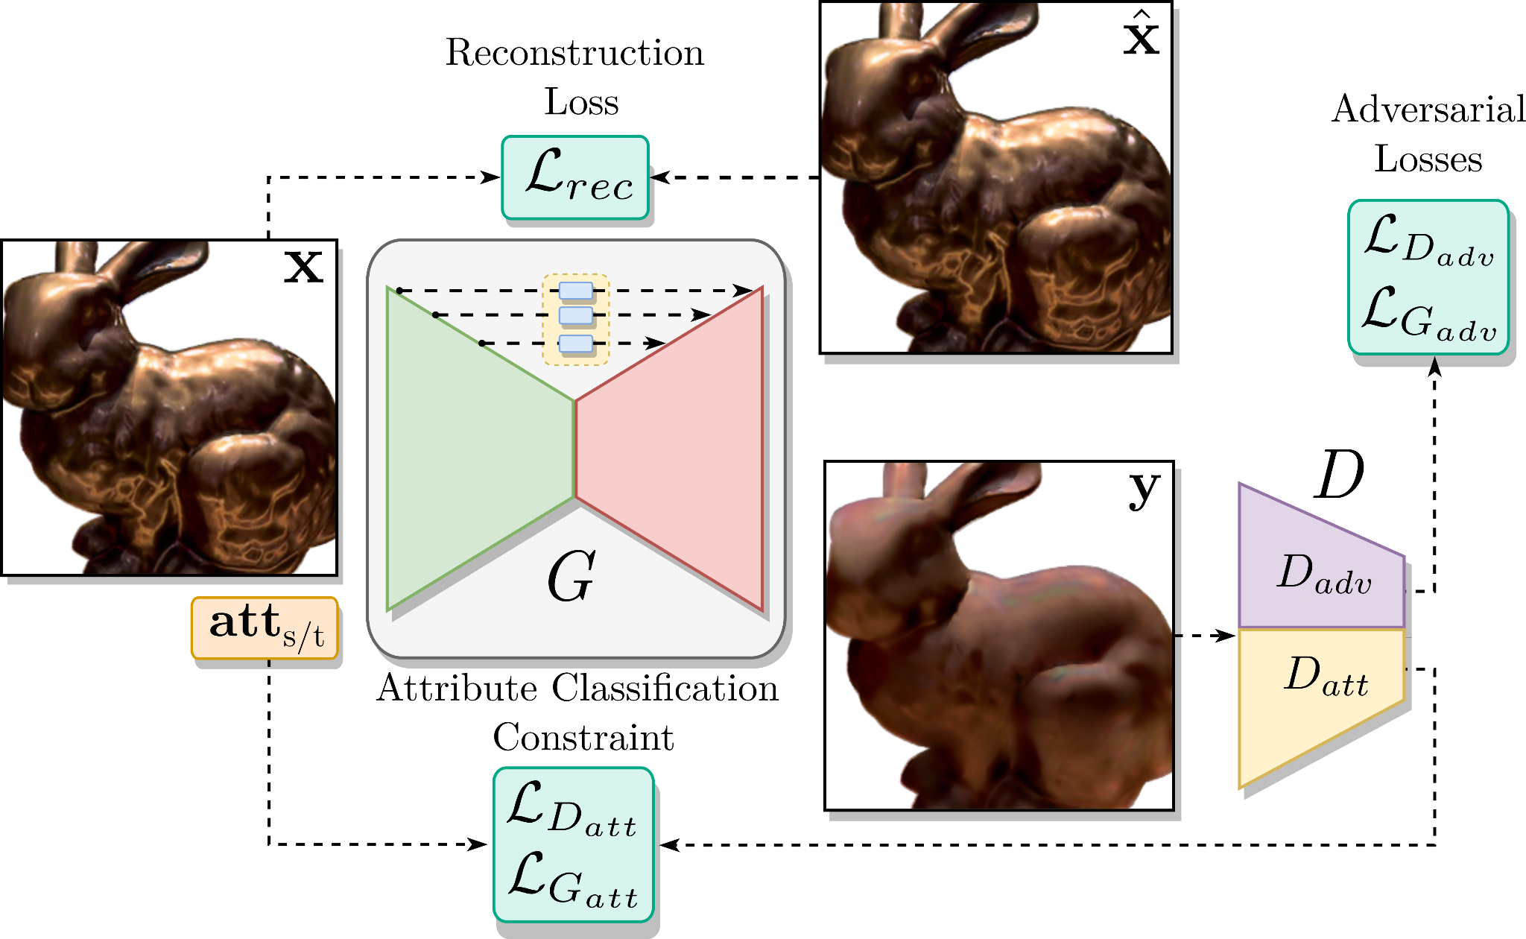
Our Framework: Training Scheme
Adversarial losses:
WGAN
11.05.2023
27
Notes:
The generator uses the input value to adjust the perceptual attribute of the image, and we use a discriminator to evaluate the similarity between the images generated by the generator and the images belong the training dataset. To achieve this, both the generator and the discriminator have to minimize their respective WGAN-GP adversarial loss functions.
27

Slide 28
Our Framework: Training Scheme
Adversarial losses:
WGAN
Attribute manipulation losses:
L1-norm
11.05.2023
28
Notes:
In addition, the generator must ensure that the edited images correlate with the input attribute value, so the discriminator also predicts the perceptual attribute level of the images while training with the user ratings.
28

Slide 29
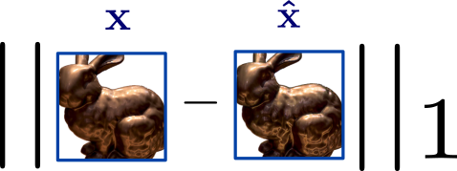
Our Framework: Training Scheme
Adversarial losses:
WGAN
Attribute manipulation losses:
L1-norm
Reconstruction loss:
11.05.2023
29
Notes:
Finally, to further improve the quality of the generated images, the generator also receives feedback on the quality of its reconstructions through a reconstruction loss function.
29

Slide 30
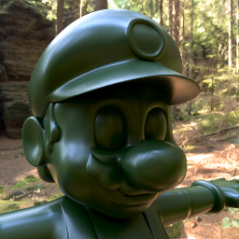
Results: Synthetic Images
Input Image
11.05.2023
30
Notes:
Once our framework has been trained, we evaluate its ability to edit images in a synthetic dataset, composed of single object scenes, and with illuminations, geometries and measured materials never seen during training. As we can see in these examples, if we train our framework to edit the glossiness, the framework is able to reduce or increase the presence of specular highlights, while preserving the high-frequency details of the geometry.
30

Slide 31
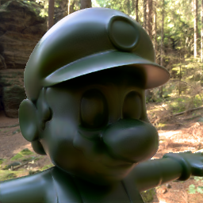
Results: Synthetic Images
Gloss
Input Image
11.05.2023
31
Notes:
Once our framework has been trained, we evaluate its ability to edit images in a synthetic dataset, composed of single object scenes, and with illuminations, geometries and measured materials never seen during training. As we can see in these examples, if we train our framework to edit the glossiness, the framework is able to reduce or increase the presence of specular highlights, while preserving the high-frequency details of the geometry.
31

Slide 32
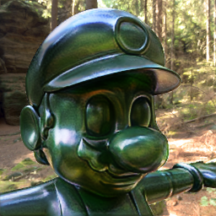
Results: Synthetic Images
Gloss
Input Image
Gloss
11.05.2023
32
Notes:
Once our framework has been trained, we evaluate its ability to edit images in a synthetic dataset, composed of single object scenes, and with illuminations, geometries and measured materials never seen during training. As we can see in these examples, if we train our framework to edit the glossiness, the framework is able to reduce or increase the presence of specular highlights, while preserving the high-frequency details of the geometry.
32

Slide 33
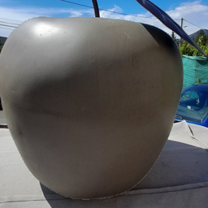
Results: Real Photographs
Input Image
11.05.2023
33
Notes:
On the other hand we also evaluate our framework on photographs, where the scene parameters are completely unknown. As we can see in this example, if we train our framwork to edit the metalness, the framework does not completely eliminate the specular highlights when the metallicity is decreased. While increasing the metallicity, the framework modify the pixel values so that the surface of the apple takes on a silvery hue.
33

Slide 34
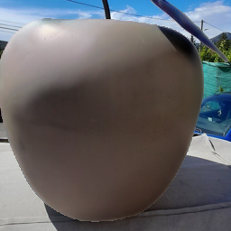
Results: Real Photographs
Metallic
Input Image
11.05.2023
34
Notes:
On the other hand we also evaluate our framework on photographs, where the scene parameters are completely unknown. As we can see in this example, if we train our framwork to edit the metalness, the framework does not completely eliminate the specular highlights when the metallicity is decreased. While increasing the metallicity, the framework modify the pixel values so that the surface of the apple takes on a silvery hue.
34

Slide 35
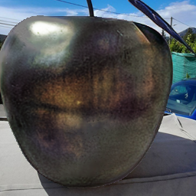
Results: Real Photographs
Metallic
Input Image
Metallic
11.05.2023
35
Notes:
On the other hand we also evaluate our framework on photographs, where the scene parameters are completely unknown. As we can see in this example, if we train our framwork to edit the metalness, the framework does not completely eliminate the specular highlights when the metallicity is decreased. While increasing the metallicity, the framework modify the pixel values so that the surface of the apple takes on a silvery hue.
35

Slide 36
Results: Comparison with SOTA [DLC*22]
11.05.2023
36
Notes:
Finally, we compare our framework with other editing strategies, starting with the previous state-of-the-art method proposed by Delanoy et al., which takes as input the target image, the attribute value, and the geometrical information of the object via a normal map. As we can see in the following images, we certainly get a very significant improvement when reconstructing images, in part because our framework is completely free of the noise that may come from a bad estimation of the geometry, as we can also see in the following table, where we compute traditional metrics that measure the similarity between the input images and the reconstructed ones.

Slide 37
Results: Comparison with SOTA [DLC*22]
Reconstrucction
11.05.2023
37
Notes:
Finally, we compare our framework with other editing strategies, starting with the previous state-of-the-art method proposed by Delanoy et al., which takes as input the target image, the attribute value, and the geometrical information of the object via a normal map. As we can see in the following images, we certainly get a very significant improvement when reconstructing images, in part because our framework is completely free of the noise that may come from a bad estimation of the geometry, as we can also see in the following table, where we compute traditional metrics that measure the similarity between the input images and the reconstructed ones.

Slide 38
Results: Comparison with SOTA [DLC*22]
Reconstrucction
Metrics
11.05.2023
38
Notes:
Finally, we compare our framework with other editing strategies, starting with the previous state-of-the-art method proposed by Delanoy et al., which takes as input the target image, the attribute value, and the geometrical information of the object via a normal map. As we can see in the following images, we certainly get a very significant improvement when reconstructing images, in part because our framework is completely free of the noise that may come from a bad estimation of the geometry, as we can also see in the following table, where we compute traditional metrics that measure the similarity between the input images and the reconstructed ones.

Slide 39
Results: Comparison with SOTA [DLC*22]
Image Editing (Gloss)
11.05.2023
39

Slide 40
Results: Comparison with SOTA [DLC*22]
Image Editing (Gloss)
11.05.2023
40

Slide 41
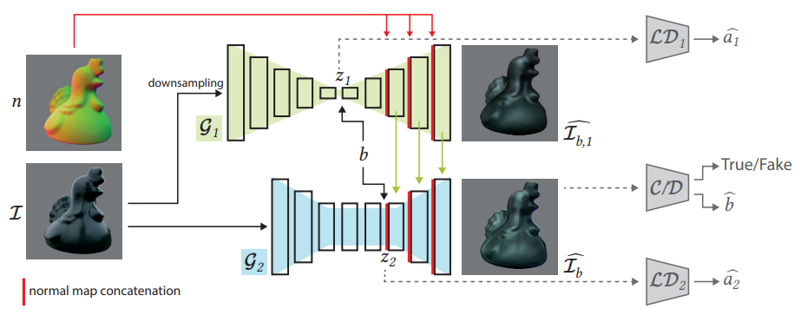
Results: Comparison with SOTA [DLC*22]
DLC*22 Architecture
Trainable Parameters
11.05.2023
41
Notes:
With respect to the Delanoy et al. architecture, their framework consists of two generators and three discriminators during the training process. Since our framework consists of only one generator and one discriminator, we also reduce the number of trainable parameters and achieve a significant memory reduction as can be seen in the table on the right.

Slide 42
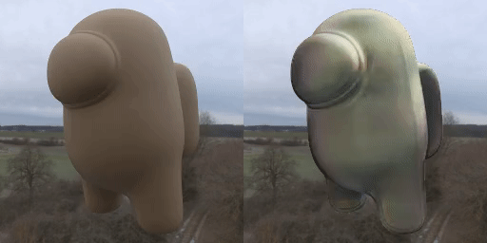
Results: Video Editing
Original
+ Gloss
11.05.2023
42

Slide 43
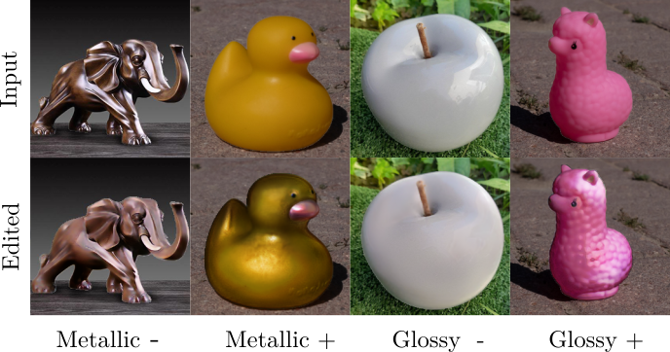
Discussion: Conclusions
STGAN architecture for high-frequency conservation
Intuitive editing without supplementary information
Plausible appearance editing in the wild
Less input data and memory usage
Our method outperforms the state of the art
11.05.2023
43
Notes:
We have demonstrated that the STGAN architecture has great potential in appearance editing tasks, allowing us to avoid estimating additional scene parameters even when working in the wild, as our method improves on the state of the art.

Slide 44
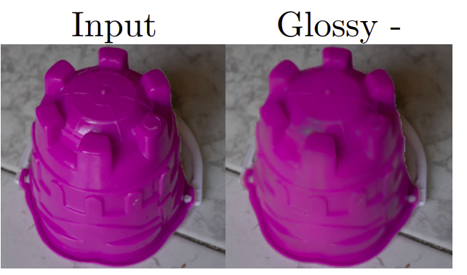
Discussion: Limitations and Future Work
Specular highlights in corner cases
Investigate other attributes
Edit high-resolution images
Stability in video sequences
11.05.2023
44
Notes:
But obviously our method is not free of limitations, since it has editing problems in corner cases, for example when the glossiness is reduced by introducing a value of 0. Since this may be due to a generalization problem, it could be interesting to train the framework with richer datasets in terms of materials. On the other hand, one could also consider training the framework to edit other attributes instead of glossiness or metalness. Also, at the moment you can only edit low resolution images, 256px, so it could also be interesting to try to adapt the architecture to work with higher resolution images or increase the stability while editing video sequencies.

Slide 45
Acknowledgments
Thanks for the Funding 😊
CHAMELEON I-2016-004
11.05.2023
45

Slide 46
It’s Over
Thanks for your Attention 😊
Contact:
dsubias@unizar.es
Code and dataset available:
11.05.2023
46

Slide 47
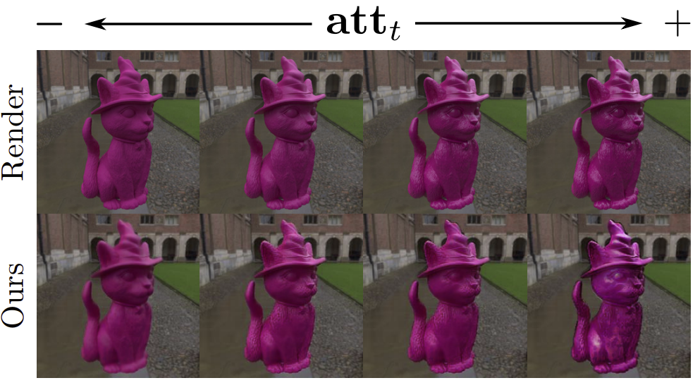
Supplementary Results: Comparison with PBR
Image Editing (Gloss)
11.05.2023
47

Slide 48
Supplementary Results: Trade-off Parameters
11.05.2023
48

Slide 49
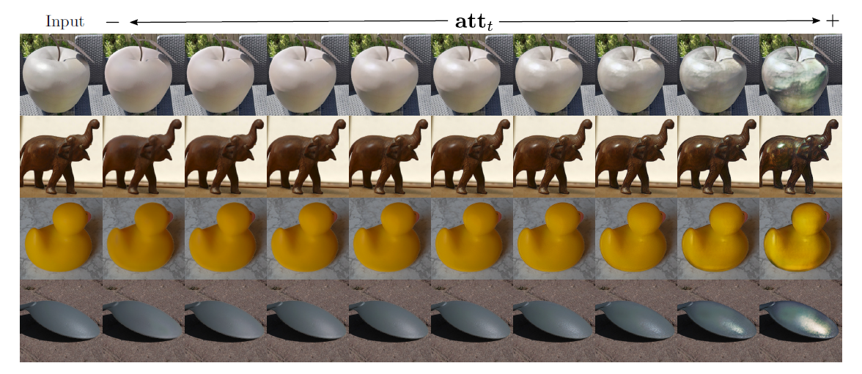
Supplementary Results: Editing
Image Editing (Gloss)
11.05.2023
49

